Slide 1

FINAL YEAR PROJECT
KutumbSetu
(कुटुम्बसेतु)
A Smart Community Management System
TEAM (GROUP 10)
Rishik Jariwala | Nirmay Patel | Rishi Soni
PROJECT GUIDE
Mr. Pankaj D. Rathod
COLLEGE
SVKM's Shri Bhagubhai Mafatlal Polytechnic
ACADEMIC YEAR
સમસ્ત દરજી સમાજ બાબરિયાવાડ
2026 – 27
Notes:
Introduce the project, team, guide and college. KutumbSetu means 'family bridge'.

Slide 2
Flow of the Presentation
02 | OUTLINE
01
Existing System & Motivation&Reviews of Commutree
02
Proposed System
03
System Architecture
04
Tech Stack
05
Implementation Snapshots
06
Sample Video demonstration along with user flow.
07
Future Scope
08
Conclusion
09
References and Q&A

Slide 3


Existing Solution: CommuTree
03 | EXISTING SYSTEM
What it offers
Where it falls short
Community family tree builder
Community news and announcements
Community matrimony matching
Private social network and chat
Android + iOS, 100k+ downloads
English, Gujarati, Hindi, Marathi
One generic app for dozens of communities
Contains in-app advertising
Users report crashes and slow registration approval
Not up to the mark reviews and frequent app crashes review.
Source: CommuTree App Store and Google Play listings [1]. Gaps are from the listing and user reviews.

Slide 4
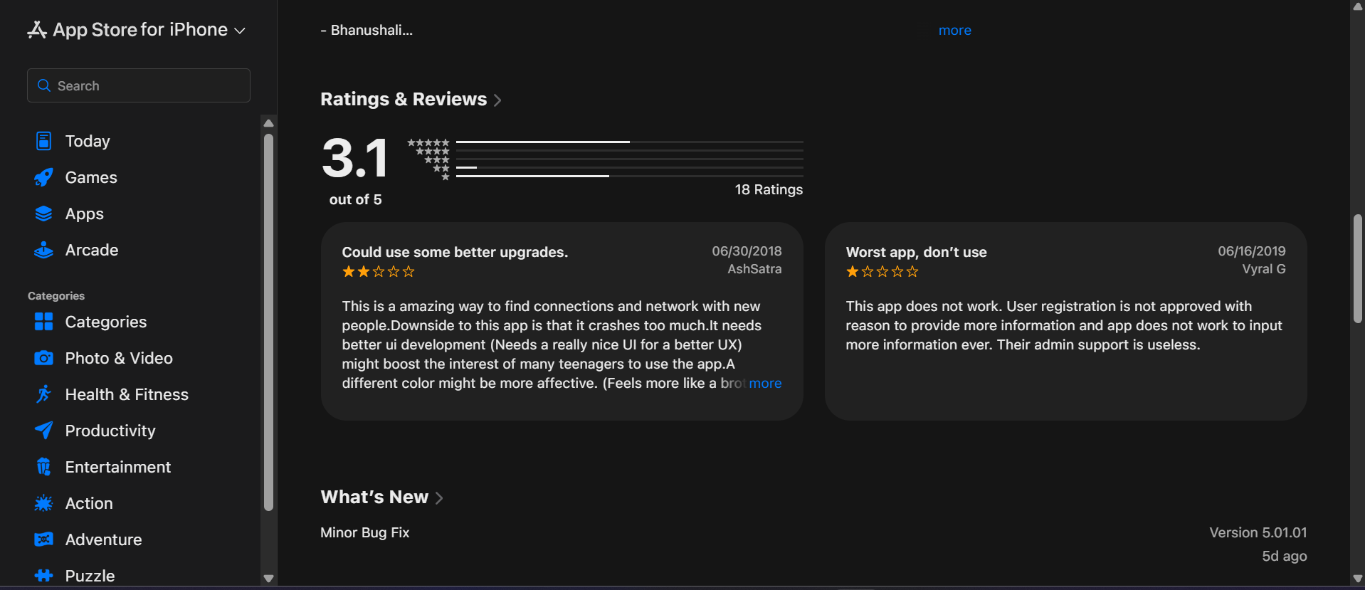
Reviews and opinions about Commutree

Slide 5


Problem Statement and Motivation
03 | PROBLEM AND MOTIVATION
Problem Statement
Motivation
Updates lost in group-chat noise
Manual, error-prone event registration
Outdated member and family records
No single place for community services
Serve 250+ families across villages and cities
One trusted source of community data
Secure, simple access on mobile
A community-owned app with its own admin

Slide 6

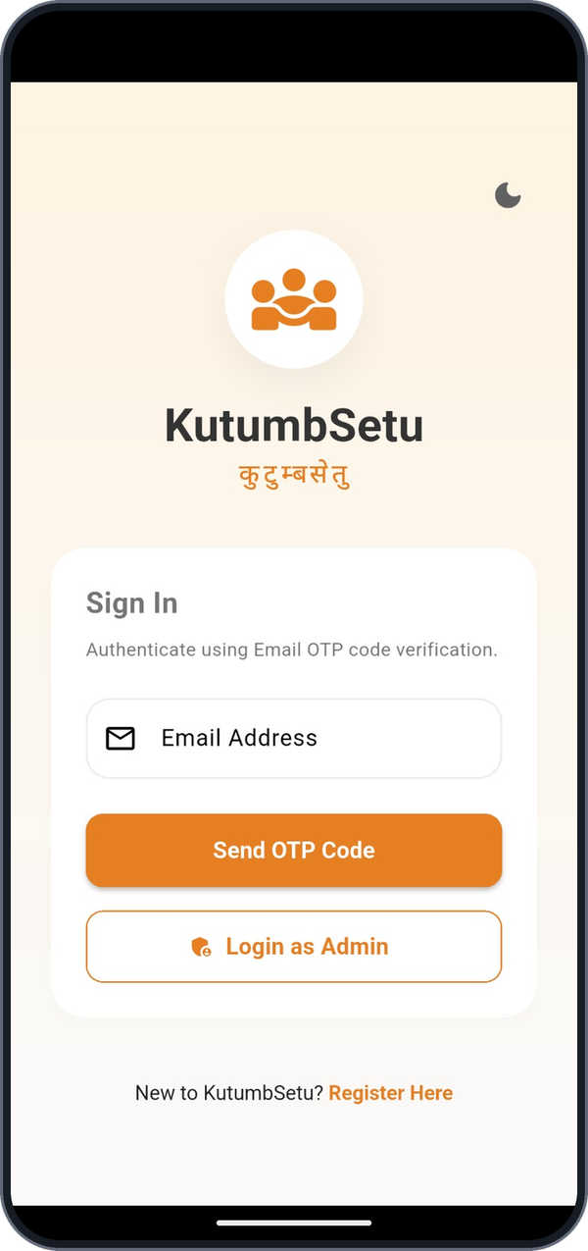
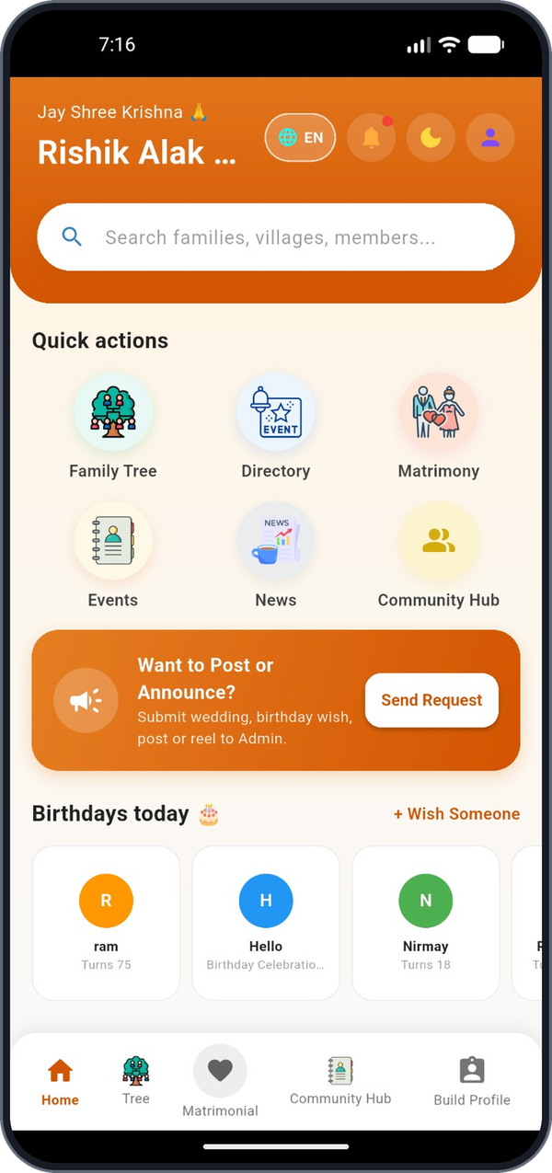




KutumbSetu: One App for the Community
04 | PROPOSED SYSTEM
Unified mobile app
Tree, directory, events, news
Secure login
Email OTP for users and admin
Profile management
Register and edit your details
Event registration
Join campaigns, get a unique ID
Admin console
Review and update registrations
Email OTP sign-in
Home dashboard

Slide 7


How KutumbSetu Works
05 | SYSTEM ARCHITECTURE
Flutter App
HTTPS / REST
Node.js / Express
Queries
MongoDB
Dart mobile interface
User and admin screens
Dark mode, multilingual
REST API layer
OTP and auth logic
Event and profile endpoints
Users and family data
Events and campaigns
Registration records
Email OTP verification workflow
1
Enter email
2
API emails OTP
3
Enter code in app
4
API verifies code
5
Session starts

Slide 8


Technologies and Tools Used
06 | TECH STACK
Frontend
Mobile UI
Flutter
Dart
Backend
API and logic
Node.js
Express.js
REST API
Database
Data storage
MongoDB
Testing
UI and API checks
Appium
API testing tools
DevOps
Build and deploy
Git / GitHub
Docker
Docker Compose
Ansible
AWS EC2

Slide 9
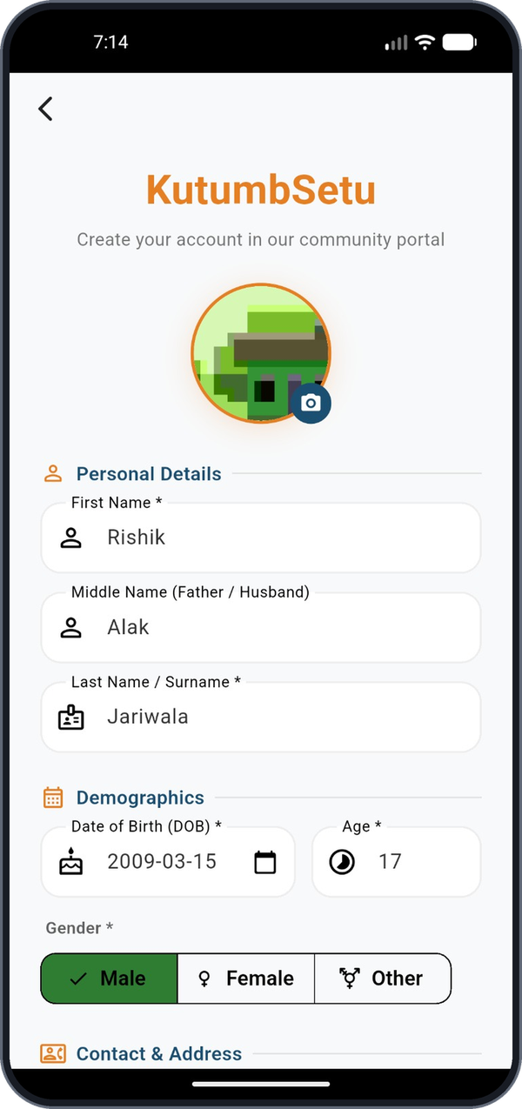
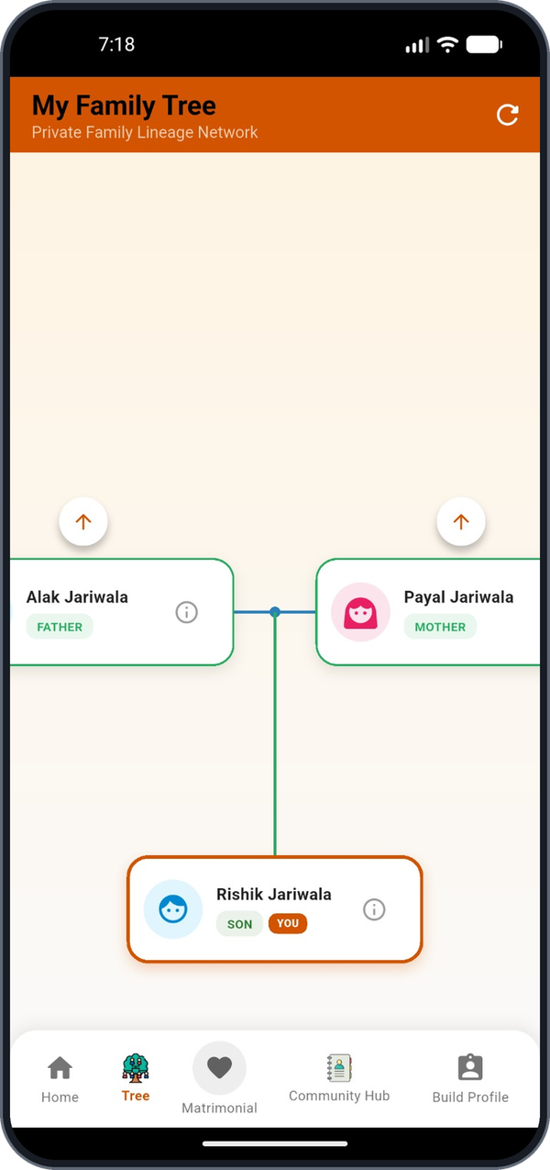
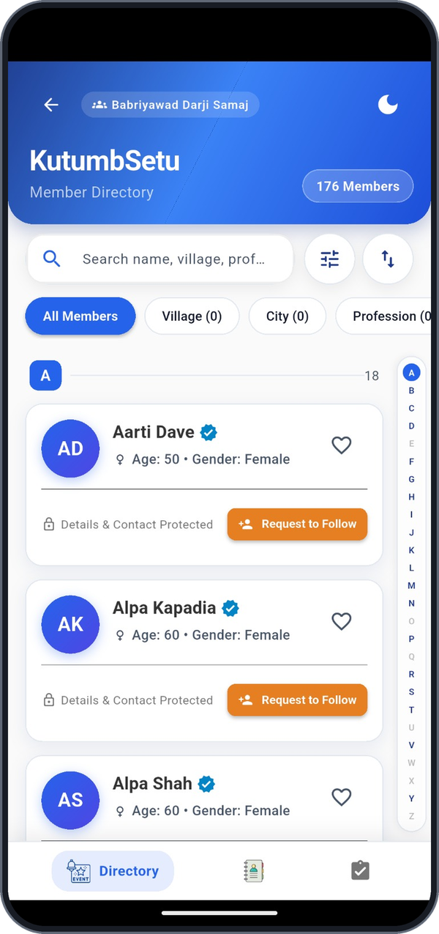
Implementation Snapshots: User App
07 | IMPLEMENTATION SNAPSHOTS (1/2)
Email OTP login
Registration
Home dashboard
Family tree
Member directory

Slide 10
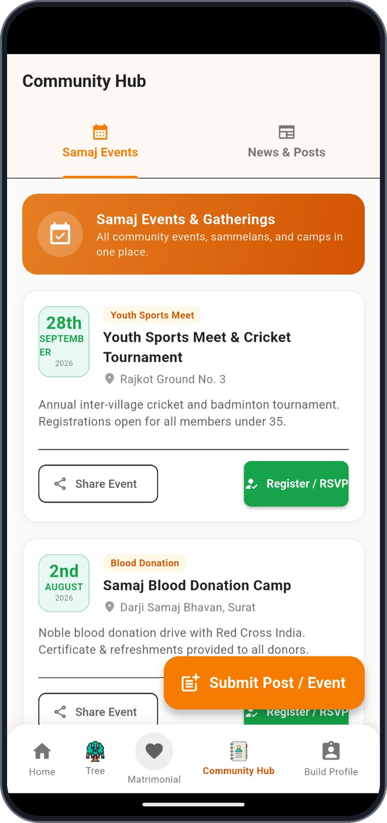
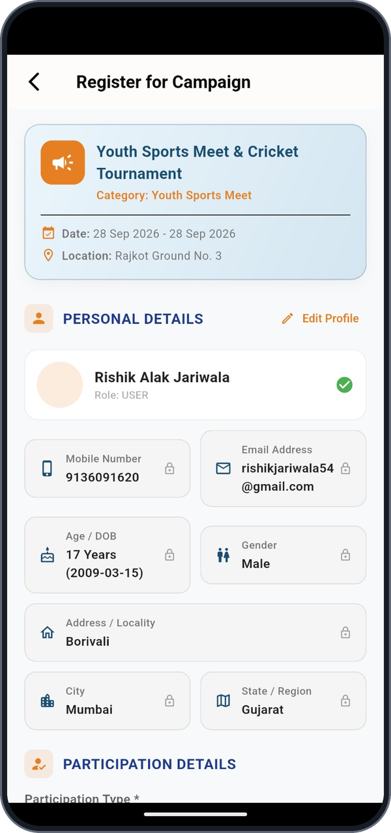
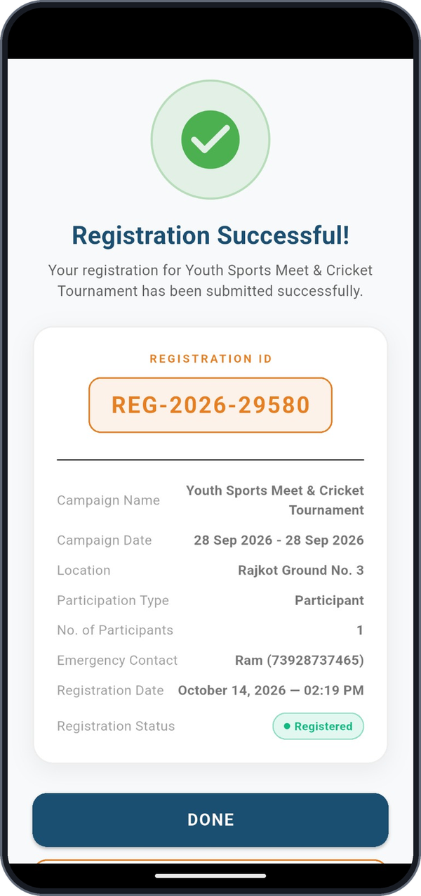
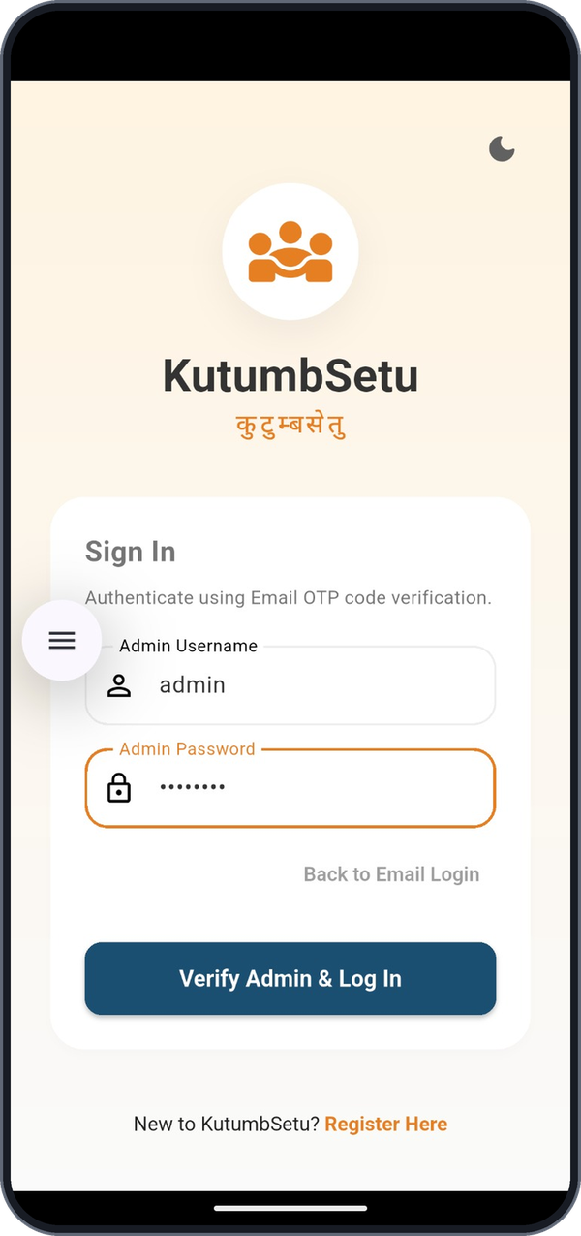
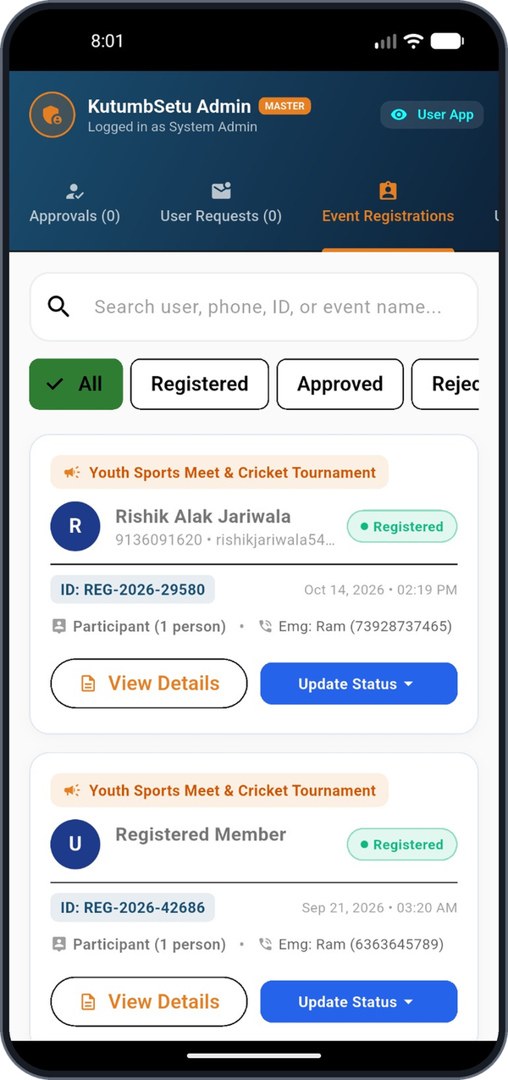
Implementation Snapshots: Events and Admin
07 | IMPLEMENTATION SNAPSHOTS (2/2)
Community hub
Event registration
Registration ID
Admin login
Admin panel

Slide 11
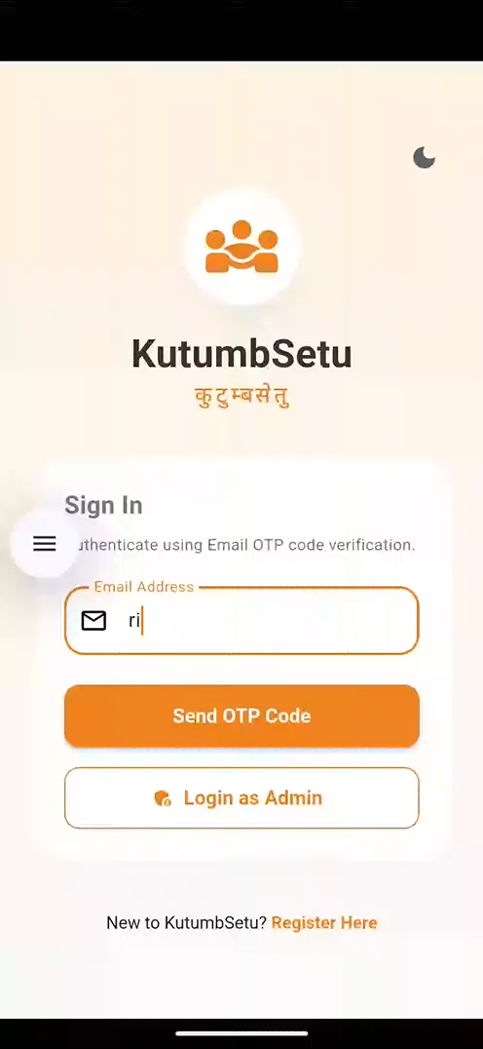
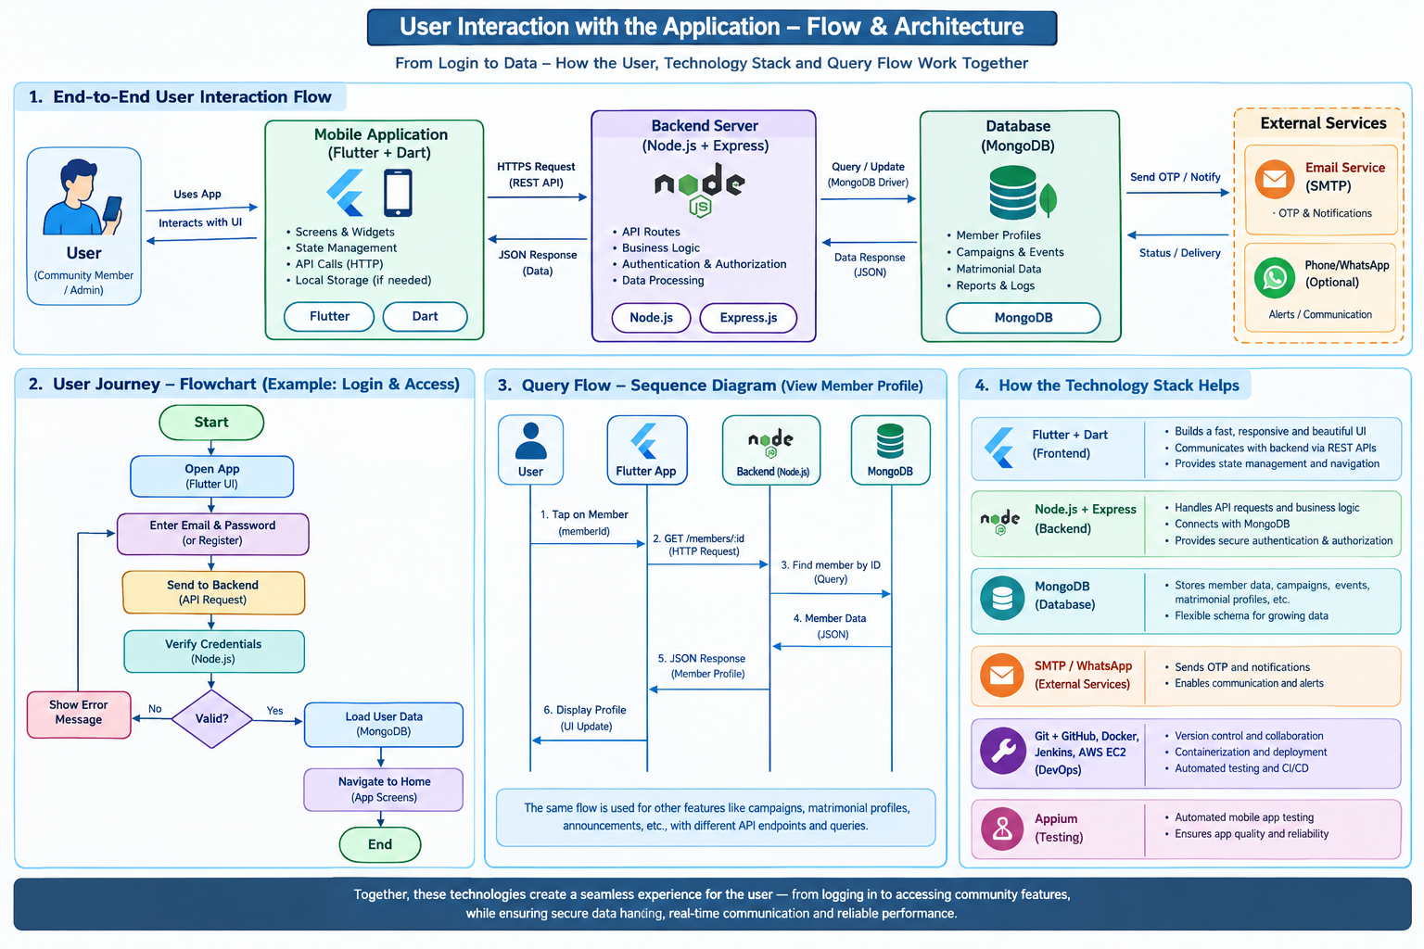
Sample Video Demo and user flow

Slide 12




What Comes Next
08 | FUTURE SCOPE
Push notifications
Alerts for events and news
Online payments
Maintenance dues in-app
Complaint tracking
Raise and follow up issues
Admin analytics
Dashboards and reports

Slide 13

Bridging the Community, Digitally
09 | CONCLUSION
100+
members in directory
6
core modules
2
roles: user and admin
Working mobile app built end to end
Secure email OTP login
Event registration with unique IDs
Admin tools to manage registrations

Slide 14
References
10 | REFERENCES
[1] CommuTree Technologies LLP, "CommuTree: Community family tree, news and matrimony," Apple App Store. [Online]. Available: https://apps.apple.com/us/app/commutree/id885813465. [Accessed: Oct. 18, 2026].
[2] Google, "Flutter documentation." [Online]. Available: https://docs.flutter.dev. [Accessed: Oct. 18, 2026].
[3] Google, "Dart documentation." [Online]. Available: https://dart.dev/guides. [Accessed: Oct. 18, 2026].
[4] OpenJS Foundation, "Node.js documentation." [Online]. Available: https://nodejs.org/en/docs. [Accessed: Oct. 18, 2026].
[5] OpenJS Foundation, "Express: Fast, unopinionated, minimalist web framework for Node.js." [Online]. Available: https://expressjs.com. [Accessed: Oct. 18, 2026].
[6] MongoDB, Inc., "MongoDB manual." [Online]. Available: https://www.mongodb.com/docs/manual. [Accessed: Oct. 18, 2026].
[7] Appium Contributors, "Appium documentation." [Online]. Available: https://appium.io/docs/en/latest. [Accessed: Oct. 18, 2026].
[8] Docker, Inc., "Docker documentation." [Online]. Available: https://docs.docker.com. [Accessed: Oct. 18, 2026].
[9] P. A. Grassi et al., "Digital identity guidelines: Authentication and lifecycle management," NIST, Gaithersburg, MD, USA, Tech. Rep. SP 800-63B, Jun. 2017.
[10] R. T. Fielding, "Architectural styles and the design of network-based software architectures," Ph.D. dissertation, Univ. California, Irvine, CA, USA, 2000.

Slide 15
Thank You
Questions?
KutumbSetu (कुटुम्बसेतु) | SVKM's Shri Bhagubhai Mafatlal Polytechnic

